Slide 1
PRESENTATION SKILLS

Slide 2
Half the world is composed of people who have something to say and can’t; the other half have
nothing to say and keep saying it.
—Lenny Laskowski

Slide 3
Purpose of Presentation
The purpose of a presentation usually is one of the following -
To Inform - to share information
To Persuade - to change opinion, behaviour, attitude, values and so on.
To Demonstrate - to help listeners know how to do something

Slide 4
Knowing the Audience
Lenny Laskowski, an international professional speaker and an expert on presentation skills, has used the word A-U-D-I-E-N-C-E as an acronym.
A Audience— Who are the members? How many will be at the event?
U Understanding— What is their knowledge about the topic I will be addressing?
D Demographics— What is their age, sex, educational background, and so forth?
I Interest— Why will they be at this event? Who asked them to be there?
E Environment— Where will I stand when I speak? Will everyone be able to see me?
N Needs— What are the listener’s needs? What are my needs as a speaker?
C Customised— How can I custom fit my message to this audience?
E Expectations— What do the listeners expect to learn from me?

Slide 5
Analysis of locale
Locale is a place and environment (situation) where the presentation is presented. Normally presentation is given in seminar hall, auditorium, conference room etc. Environment of such places largely affects the presentation. While presenting a presentation a person should keep several things in his or her mind.
Size of the auditorium or conference room
Seating arrangement for audience
Physical setting like podium, table, room temperature, lighting etc.
Electric devises like: microphones, speaker, computers etc.
Thus, proper understanding of the audience’s nature and locale make our presentation effective and successful

Slide 6
Title Selection
A strong title should be clear, concise, and intriguing
Tips for giving title to your presentation:
Use Keywords
Make it engaging
Keep it concise
Examples of Effective Presentation Titles:
"The Future of Renewable Energy: Innovations and Challenges"
"Navigating the Digital Landscape: Strategies for Success in the 21st Century"

Slide 7
The Central Idea
Understanding the Central Idea
The central idea of a presentation serves as its core thesis statement
Characteristics of a Central Idea
Simple and Audience- Centred
One-Sentence Summary
Focuses on Presentation Content
Example of a Central Idea
"In today's presentation, we will explore the impact of artificial intelligence on modern healthcare, focusing on its potential benefits, ethical considerations, and future implications."

Slide 8
Developing the Main Ideas
Logical Division of theIdea:
Example:
Central Idea: Climate Change
Logical Divisions: A. Causes of Climate Change B. Impacts of Climate Change C. Mitigation Strategies
Establishing Reasons for the Central Idea Being True
Example:
Central Idea: Renewable Energy is the Future
Establishing Reasons: A. Environmental Benefits B. Economic Viability C. Technological Advancements
Supporting the Central Idea with a Series of Steps:
Example:
Central Idea: Sustainable Urban Development
Series of Steps: A. Urban Planning and Design B. Green Infrastructure Implementation

Slide 9
Gathering Supporting Material
Steps for Gathering Supporting Material
Organise your thoughts
Recall personal knowledge and experience
Utilise research resources
Conduct interviews and discussions
Compile a list of material

Slide 10
Visual Aids
Purposes of Visual Aids:
Serve as speech notes
Boost presenter’s confidence
Focus on presentation theme
Increase audience interest
Provide clarity and precision
Types of Visual Aids:
Three-Dimensional visual aids:,objects, models, people
Two-Dimensional Visual Aids: drawings, photographs, slides, maps, graphs (Bar, Pie, Line, Picture), charts, overhead transparencies, computer-generated presentations, chalkboard

Slide 11
Content Insertion- Slides
Font
Ensure legibility by using a minimum font size of 24pt for body text.
Choose a professional and easy-to-read font style (such as Times New Roman, Arial, Calibri, or Helvetica) for all text on your slides.
Increase font size for headers and key points to emphasise importance.
Avoid using fonts smaller than 18pt to ensure readability, especially in large presentation rooms.
Font size plays a crucial role in the readability and effectiveness of your slides. By choosing appropriate font sizes, you can ensure that your audience can easily read and understand your content.

Slide 12
Content Insertion- Slides
Font Color
Choose high-contrast font colours (e.g., black or dark gray) on light backgrounds for maximum readability.
Maintain consistency in font colours throughout the presentation to enhance visual cohesion.
Use colours sparingly for emphasis, such as highlighting key points or call-to-action statements.
The choice of font colour can significantly impact the readability and visual appeal of your slides. By selecting appropriate font colors, you can enhance the clarity and impact of your message.

Slide 13
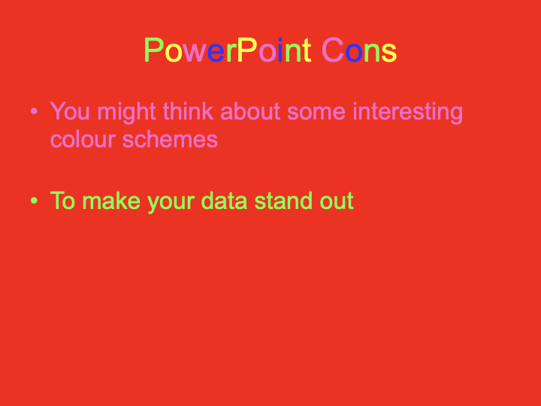
Example of poor colour combination

Slide 14
Content Insertion- Slides
Slide Themes
Select a cohesive and professional theme that reflects the tone and content of your presentation.
Choose themes with clean layouts and visually appealing design elements to enhance engagement.
Avoid overly complex or distracting themes that detract from your message.
Slide themes provide the visual framework for your presentation. By choosing the right theme, you can create a visually cohesive and engaging presentation that reinforces your message.

Slide 15
Design Elements
Utilise visual hierarchy to prioritise important information and guide the viewer's attention.
Maintain consistency in fonts, colors, and layouts across all slides for a cohesive visual identity.
Incorporate ample white space to reduce clutter and improve readability.
Effective use of design elements can enhance the clarity and impact of your presentation. By following design principles such as visual hierarchy and consistency, you can create visually appealing slides that effectively communicate your message.

Slide 16
Content Insertion- Slides
Additional Tips
Use bullet points or short phrases to convey ideas succinctly and prevent overcrowding of slides
write only 5-6 bullet points on one slide
write only 5-6 words in each point
Incorporate visuals such as images, graphs, and diagrams to enhance understanding and retention.
Experiment with slide transitions sparingly to add visual interest without detracting from your message.
In addition to font size, colour, themes, design elements, and background colour, there are several other factors to consider when creating powerful presentations. By implementing these additional tips, you can further enhance the effectiveness and visual appeal of your slides.

Slide 17
Delivering a Presentation
Start With Confidence
Begin your presentation with a startling statement, quotation, anecdote, question, or joke to capture the audience's attention.
Ensure that your opening technique aligns with your message and emphasises your main point.
Draw from personal and professional experiences to add depth and authenticity to your presentation.
Practice and plan your opening to deliver it with confidence and impact.
Starting your presentation with confidence sets the tone for a successful delivery and engages your audience from the outset. By choosing an effective opening technique and practicing it beforehand, you can establish credibility and capture your audience's interest.

Slide 18
Delivering a Presentation
Be Organised
Structure your presentation with a clear introduction, body, and conclusion.
Provide an overview of the main points in the introduction and make the purpose of your presentation clear.
Use transitions and signposts to guide the audience through the organisation of your presentation.
Incorporate credible and interesting supporting material to reinforce your main points.
Organising your presentation effectively ensures that your message is conveyed clearly and coherently. By structuring your presentation with a logical flow and incorporating compelling supporting material, you can keep your audience engaged and focused on your message.

Slide 19
Delivering a Presentation
Pay Attention to Body Language
Use effective gestures, body movements, and walking patterns to make a positive impression on the audience.
Maintain eye contact with the audience throughout the presentation to establish rapport and connection.
Rehearse your presentation to ensure that your body language enhances your message and reinforces key points.
Body language plays a crucial role in communication and can greatly impact how your message is received. By paying attention to your gestures, movements, and eye contact, you can enhance your presence and credibility as a speaker.

Slide 20
Delivering a Presentation
Close in a memorable way
Conclude your presentation with a summary of key points to reinforce your message.
Leave the audience with a positive impression of you and your presentation by delivering a memorable closing statement.
Encourage audience engagement and further discussion to ensure a lasting impact beyond the presentation.
Closing your presentation in a memorable way leaves a lasting impression on your audience and reinforces your message. By summarising key points and engaging your audience in reflection or discussion, you can create a memorable and impactful conclusion.

Slide 21
Summary
https://hbr.org/2013/06/how-to-give-a-killer-presentation
Find out as much as you can about what will be expected of you (audience, venue, time, who else is speaking)
Plan, Prepare and Practice
Use appropriate technologies
Remember the opera singer – be passionate, be heard, and make your audience feel involved.

Slide 22
Thanks

